Slide 1


NEXT GEN EMPLOYABILITY PROGRAM
CREATING A FUTURE-READY WORKFORCE
Student Name :
Rahul Birdhaiya
Student ID :
College Name :
STU674ad11983c3c1732956441
CENTRE FOR ADVANCED COMPUTER TRAINING B.J.S. at Idgah Hills, Bhopal

Slide 2
CAPSTONE PROJECT SHOWCASE
Project Title
The Travel Trunk
Abstract | Problem Statement | Project Overview | Proposed Solution | Technology Used | Modelling & Results | Conclusion | Q&A

Slide 3
Abstract
1
Tour Listings: Display a list of available tours with details such as title, description, price, and ratings.
2
Search Functionality: Allow users to search for tours based on keywords.
3
User Authentication: Enable users to register, log in, and log out.
4
Booking System: Allow users to book tours and manage their bookings.

Slide 4


Problem Statement
Implementing Voice Search
Speech Recognition Compatibility
Handling Voice Search Errors
Integration of Frontend and Backend
Connecting Bookings with Backend Data
CORS Issues : Configured CORS settings
Asynchronous Data Fetching.
User Authentication and Authorization
Scalability and Performance
User Experience and Interface Design

Slide 5

Project Overview
Objective: Provide a seamless platform for exploring, searching, and booking.
Key Features:
Tour Listings: Detailed information on available tours.
Search Functionality: Keyword and voice search capabilities.
User Authentication: Secure registration, login, and logout.
Booking System: Easy tour booking and management.
Reviews and Ratings: User reviews and ratings for tours.
Technologies Used:
Frontend: React, React Router, Bootstrap, CSS.
Backend: Node.js, Express.js.
Database: MongoDB.
Authentication: JWT (JSON Web Tokens).
Challenges and Solutions:
Voice Search: Ensuring compatibility and accuracy.
Frontend-Backend Integration: Handling CORS and consistent API endpoints.
Booking Data Synchronization: Real-time updates and secure data handling.
Scalability: Modular architecture and performance optimization.
Future Enhancements:
Payment Integration: Adding payment gateways.
Advanced Search Filters: More refined search options.
User Profiles: Profile management and booking history.

Slide 6
Proposed Solution
Centralized Tour Information: Consolidate all tour details (title, description, price, ratings) in one platform.
Streamlined Booking Process: Simplify the booking workflow with an intuitive user interface.
Enhanced Search Functionality: Enable keyword-based search for quick tour discovery.
User Authentication and Security: Protect sensitive user data with HTTPS and secure storage practices.
User Engagement Features: Foster a community of travelers through user-generated content.
Scalable Architecture: Optimize database queries and implement caching strategies for performance.
Responsive Design: Use Bootstrap and CSS media queries for a responsive user interface.
Real-Time Data Synchronization: Ensure data consistency between frontend and backend.
Comprehensive Error Handling: Provide clear user feedback and retry options in case of errors.

Slide 7
Technology used
Frontend: React, React Router, Bootstrap, CSS
Backend: Node.js, Express.js
Database: MongoDB
Authentication: JWT (JSON Web Tokens)
API: RESTful API
Speech Recognition: Web Speech API
Real-Time Updates: WebSocket's (if applicable)
Development Tools: Visual Studio Code, Postman (for API testing).
Version Control: Git, GitHub

Slide 8
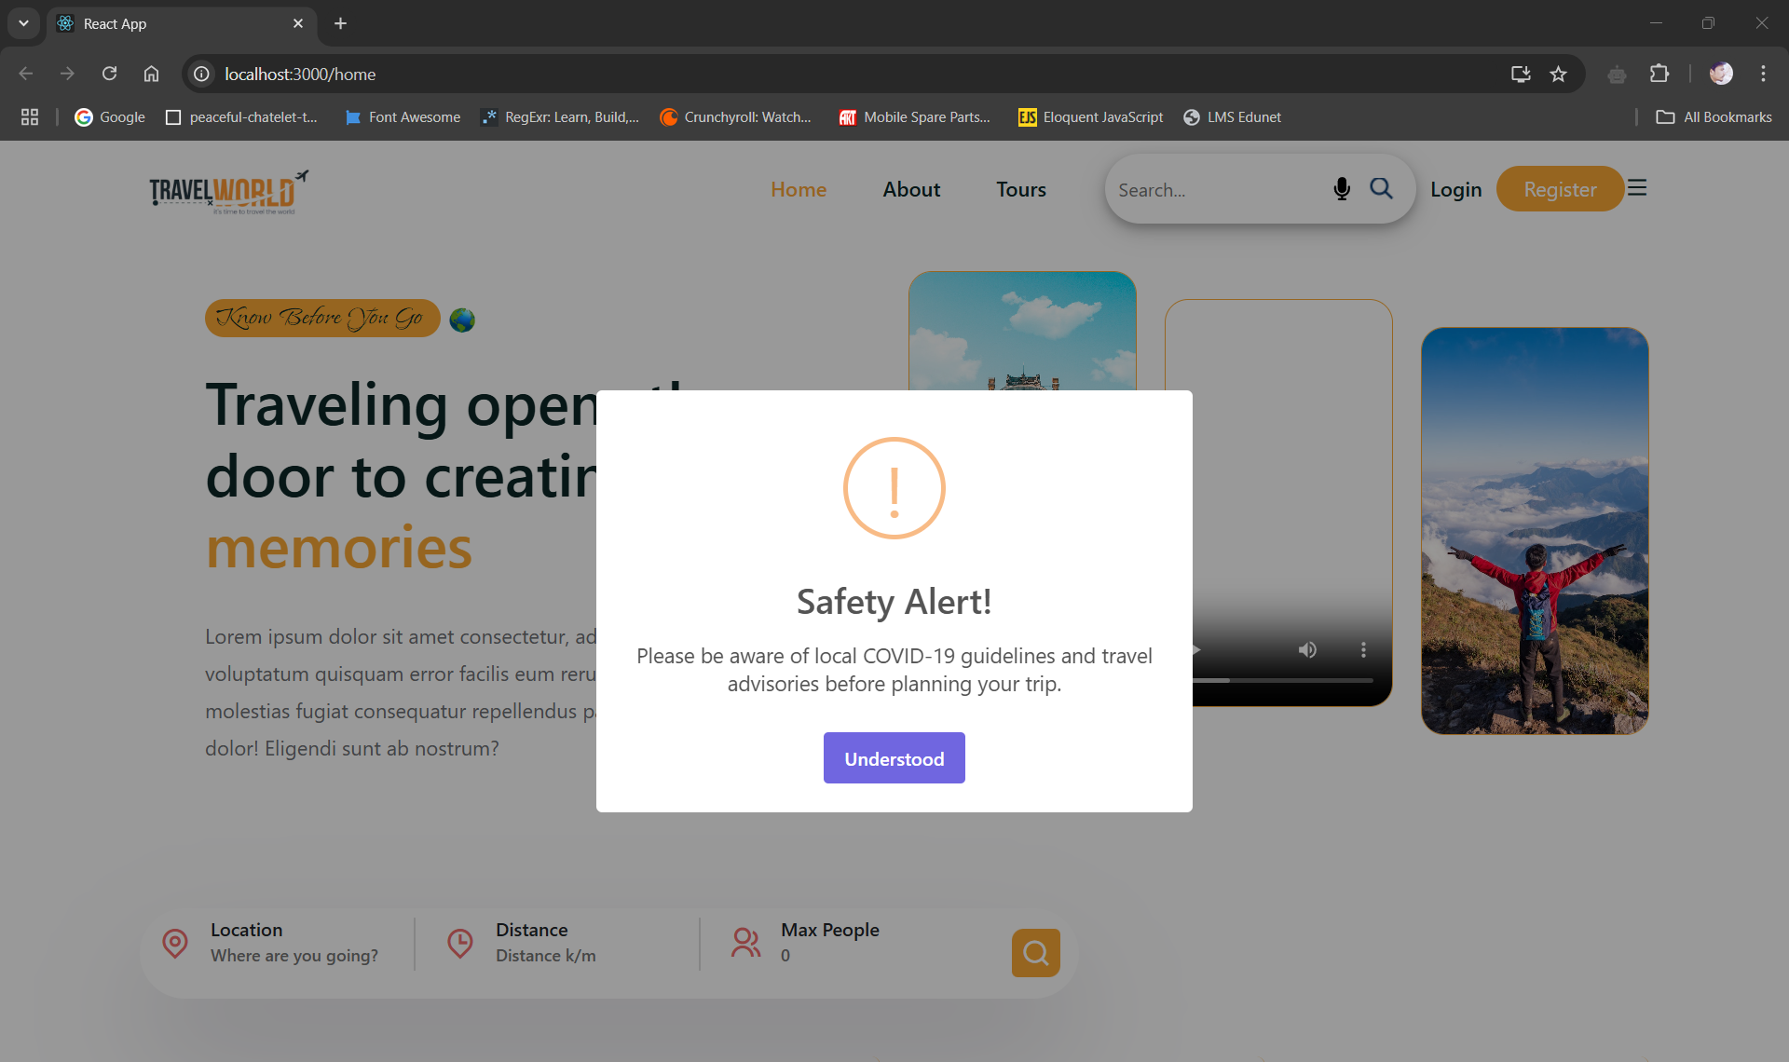
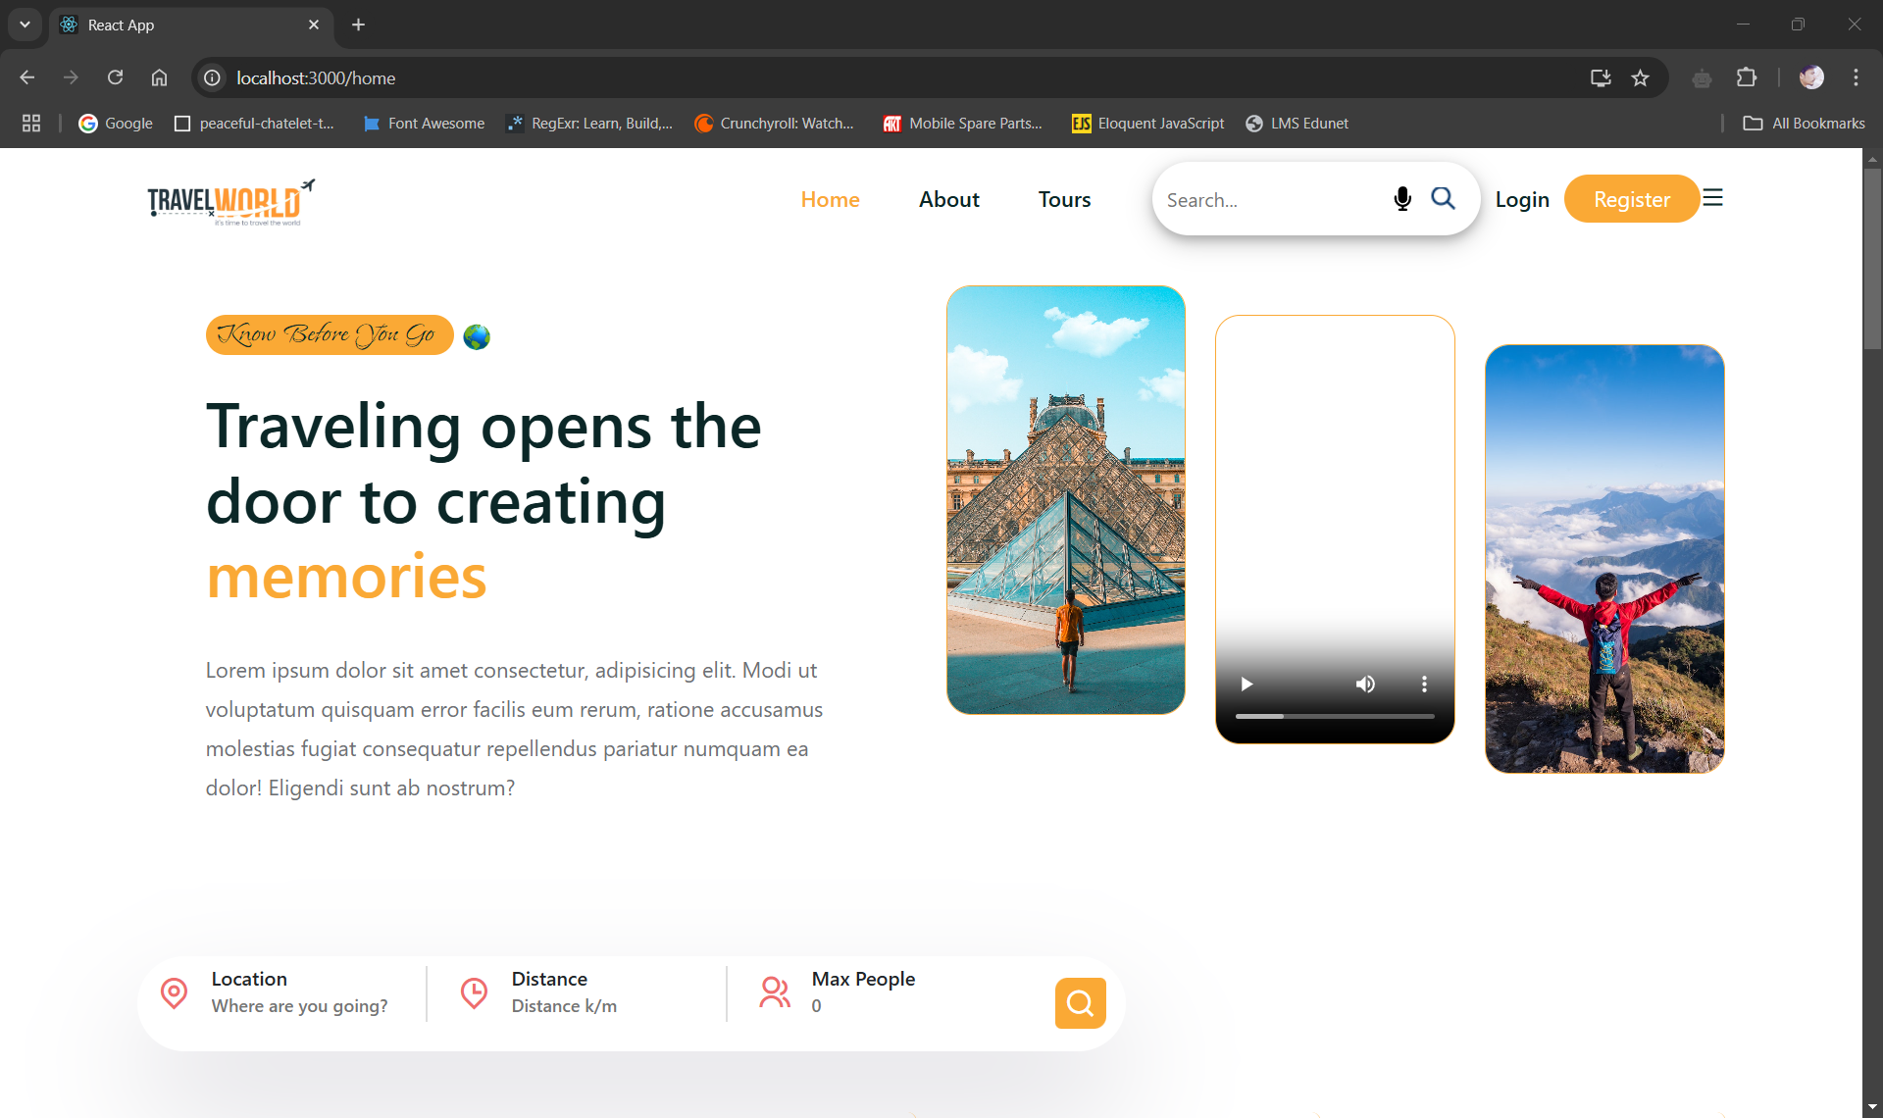
Modelling & Result

Slide 9
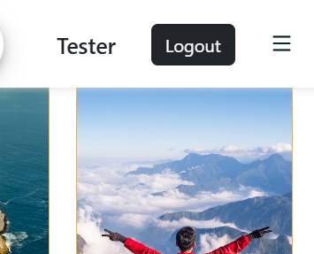
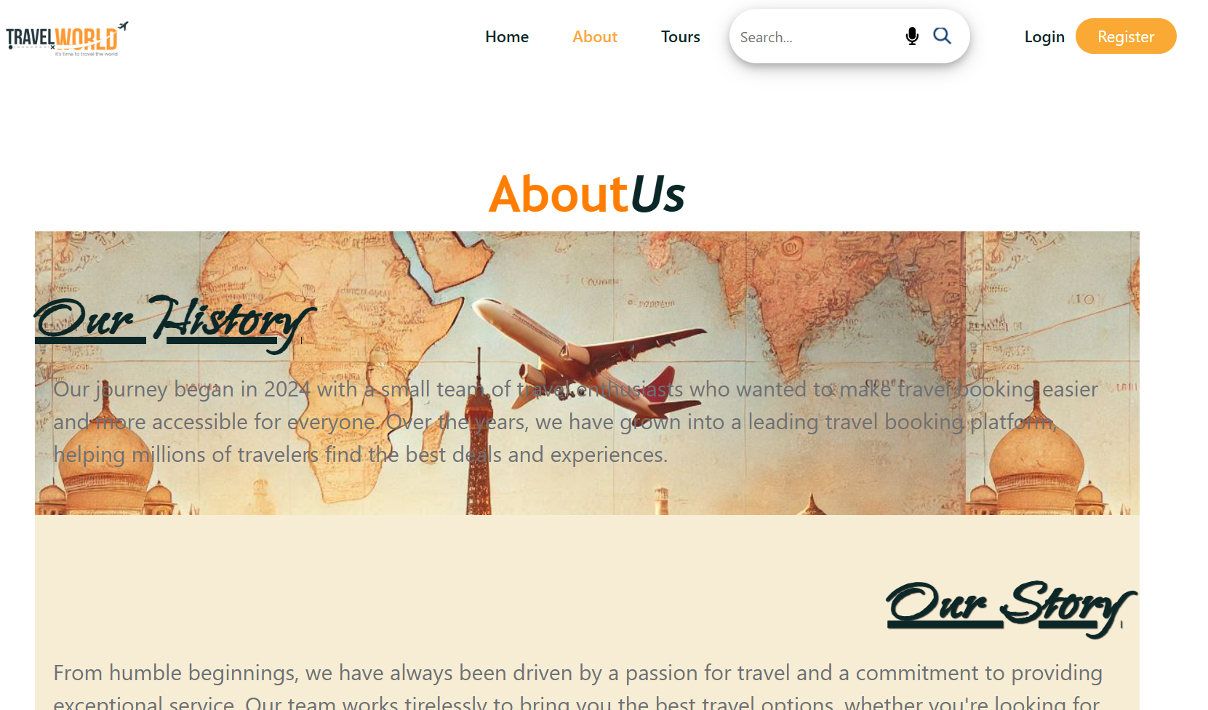
Modelling & Result

Slide 10
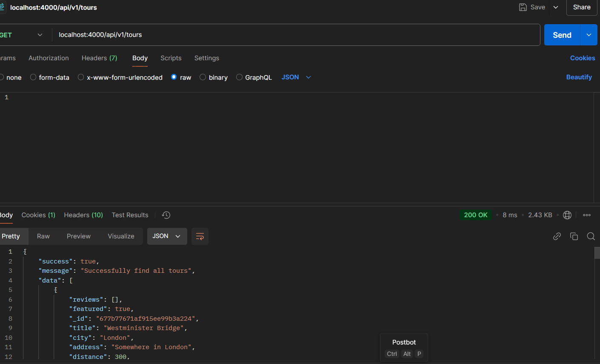
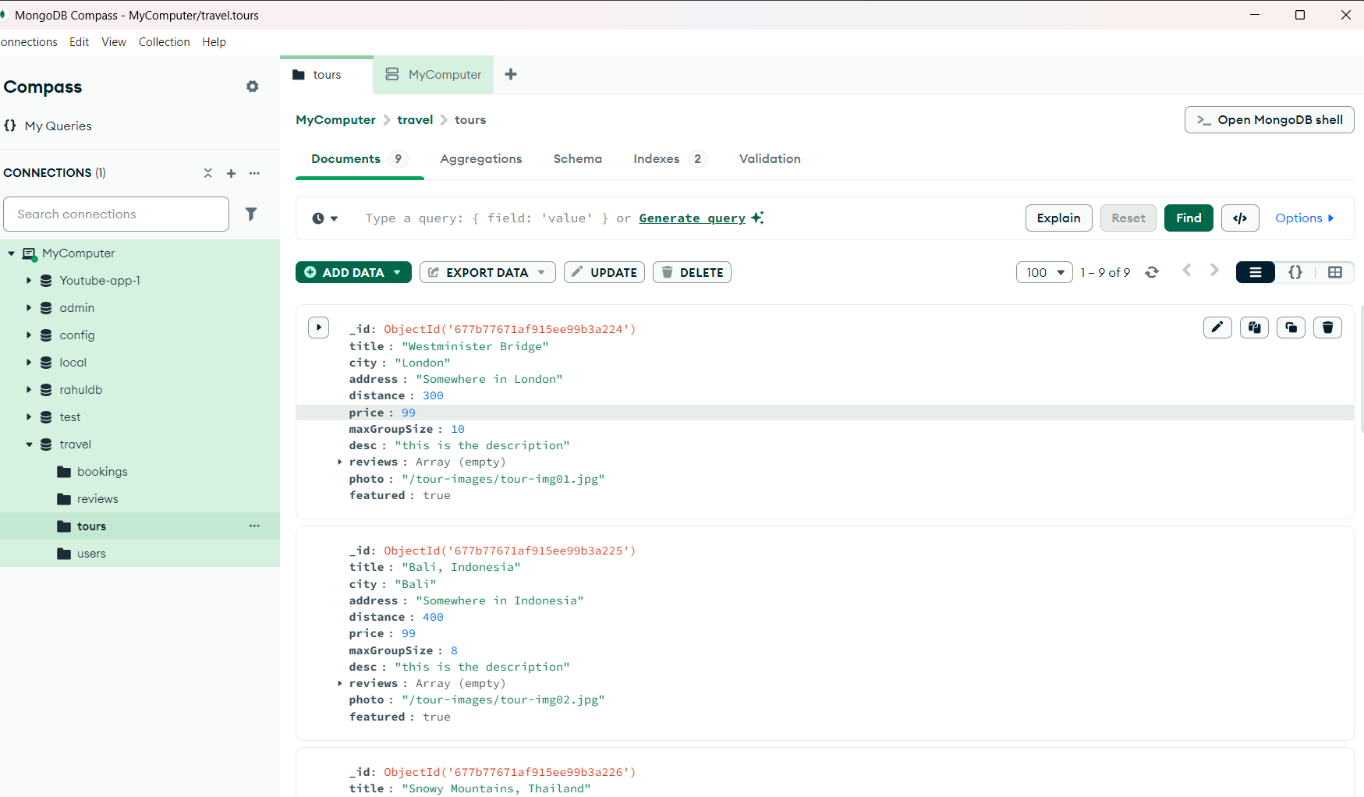
Modelling & Result

Slide 11

Conclusion
Enhanced User Experience.
Comprehensive Platform.
Secure and Scalable.
Future-Ready.
User Engagement.
Responsive Design.
Efficient Search.
Real-Time Updates.
Robust Error Handling.

Slide 12


Notes:
Thank You !!

